Slide 1

Leave no child behind: Global report on boys' disengagement from education

Slide 2

Key data: Participation and progression in education and learning outcomes
Boys more likely to repeat primary grades in 130 out of 142 countries
In 73 countries, less boys than girls are enrolled in upper-secondary education, while the opposite is the case in 48 countries
Globally 88 men are enrolled at university for every 100 women
In 57 countries, 10-year-old boys fare worse
than girls in mastering reading skills
118.5 million girls and 125.5 million boys are out of school globally

Slide 3
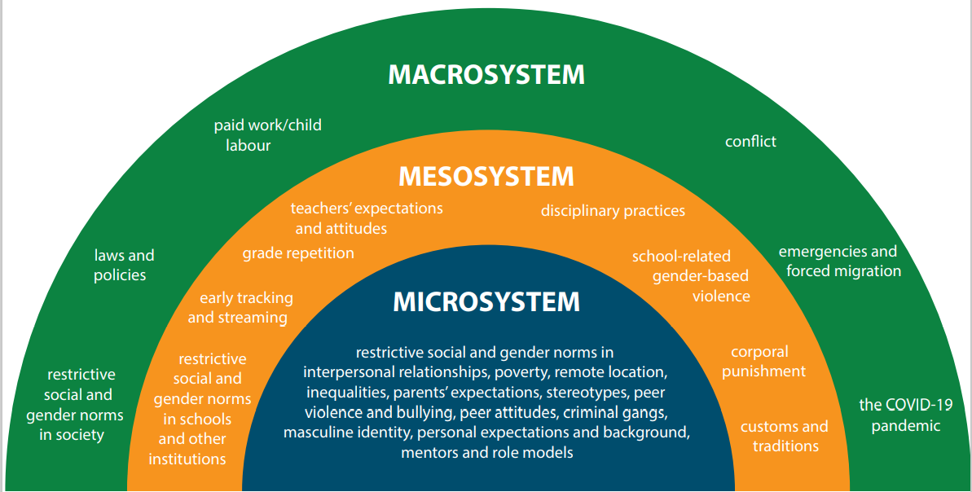
Multiple factors contribute to boys’ disengagement from education

Slide 4

Why does it matter?
Addressing boys’ disengagement matters for boys, girls and society
Educated men are more likely to:
treat women and men equally
condemn gender-based violence
help in the household and take on care responsibilities
Men with higher educational attainment have better health and well-being and are less likely to engage in criminal activities
Supporting boys is not a zero-sum game – targeted action in favour of boys does not mean that girls lose out and vice versa
Flickr - World Bank Photo Collection. Students at Catholic University of Peru. © World Bank/Dominic Chavez. Available under CC BY-NC-ND 2.0

Slide 5
Overal recommendations
Need to:
Advance equal access to education and prevent boys’ dropout
Make learning gender-transformative, safe and inclusive for all learners
Invest in better data and generate evidence to better understand boys’ educational participation, progression and learning outcomes, including the most marginalized
Build and finance equitable, inclusive and gender-transformative education systems
Promote and ensure integrated, coordinated and system-wide approaches to address boys’ disengagement from education

Slide 6
Matthias Eck
m.eck@unesco.org
UNESCO

